Slide 1
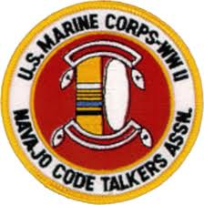
Navajo Code Talkers
Native Language as a Weapon

Slide 2
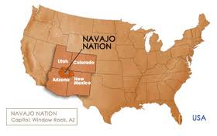
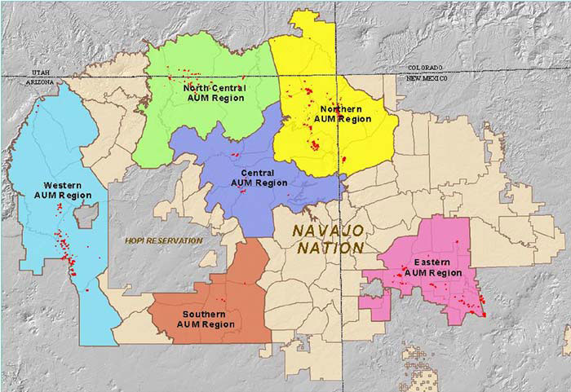
The Navajo People
The Navajo are located in the Southwestern United States
The Navajo are believed to have migrated from northwestern Canada and eastern Alaska, where the majority of Athabaskan speakers reside.

Slide 3
Early History
The Navajo came into official contact with the United States of America in 1846 during the Mexican American War.
In 1861 a series of military actions were undertaken against the Navajo by Kit Carson.
Facing starvation and death, the last group of Navajo surrendered at Canyon de Chelly and were taken to Fort Defiance for internment on July 20, 1863.

Slide 4
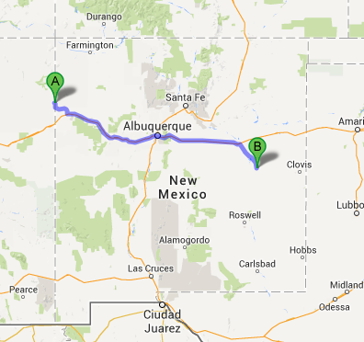
Long Walk
Beginning in the spring of 1864, around 9,000 Navajo men, women and children were forced to embark on a trek of over 300 miles to Fort Sumner, New Mexico for internment at Bosque Redondo. This is known as the Long Walk
In 1868, a treaty was negotiated between Navajo leaders and the Federal government allowing the surviving Navajo to return to a reservation on a portion of their former homeland.

Slide 5
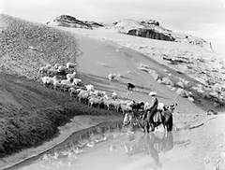
Early History
The United States military continued to maintain forts on the Navajo reservation in the years following the Long Walk.
By treaty, the Navajo were allowed to leave the reservation for trade with permission from the military or local Indian Agent. Eventually, the arrangement lead to a gradual end in Navajo raids as the tribe was able to increase the size of livestock and crops.
In the 1930s, the United States government claimed the Navajo's livestock were overgrazing the land and killed more than 80% of the livestock, in what is known as the Navajo Livestock Reduction
In the 1940s, during World War II, the United States denied the Navajo welfare relief because of the Navajos’ communal society.
During this time the Navajo language use in schools etc were forbidden and discouraged.

Slide 6
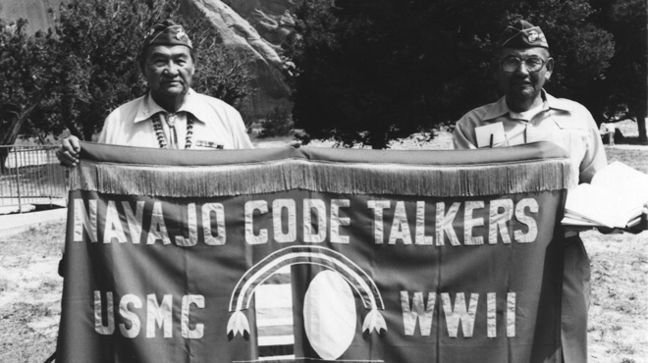
Meeting a need
Though in United States history, the story of Native Americans is predominantly tragic, during World War II, the U.S. government needed the Navajos' help. And the Navajos proudly answered the call to duty.

Slide 7
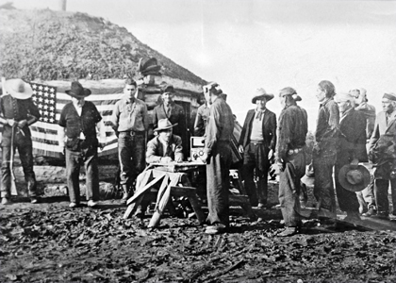
World War II
After the bombing of Pearl Harbor many young Navajo men voluntarily signed up to join the war effort – some arriving at various forts with their own rifles.
Some of the young men said the atrocities committed by the Japanese against their Asia pacific neighbors reminded them of the ‘long walk’ and they felt the need to do something.
Notes:
Some of the young men said the atrocities committed by the Japanese against their Asia pacific neighbors reminded them of the long walk and they felt the need to do something.

Slide 8
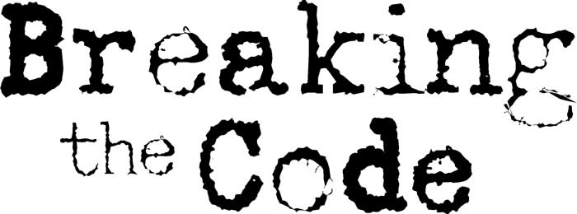
Communication in Times of War
Communication is essential during any war and World War II was no different. From battalion to battalion or ship to ship - everyone must stay in contact to know when and where to attack or when to fall back.
If the enemy were to hear these tactical conversations, not only would the element of surprise be lost, but the enemy could also reposition and get the upper hand.
Codes (encryptions) were essential to protect these conversations.

Slide 9
Can’t Keep a Secret!
As hard as the United States was working hard to break codes created by the enemy, they were also trying to keep their codes from being broken.
The American offensive in the Pacific during World War II [was] hampered by the Japanese ability to crack the most secret U.S. Codes.
During the early months of WWII, Japanese intelligence experts broke every single code the US forces devised [For example, what if an out of the way station (on either side) would report in, ‘Nothing to report’ every morning using the new code. That would give the enemy a key to the cipher] and the US was growing desperate…

Slide 10
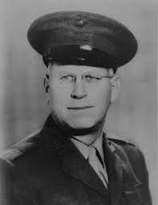
How the Code Was ‘Found’
Phillip Johnston, a former army man then civilian living in California (an engineer for the city of Los Angeles) had an idea
As the son of a Protestant missionary, Johnston had grown up on the Navajo reservation with Navajo children, learning their language and their customs.

Slide 11
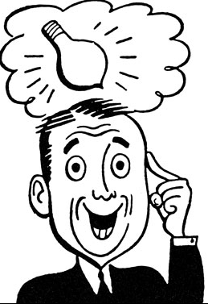
A Good Idea!
Then one day, Johnston was reading the newspaper when he noticed a story about an armored division in Louisiana that was attempting to come up with a way to code military communications using Native American personnel. This story sparked an idea.
In February 1942, Philip Johnston approached Major James E. Jones, Force Communications Officer at Camp Elliot in San Diego, with a plan to use the Navajo language for battlefield radio transmissions.
Navajo People have the highest utilization of the
Native language among all tribes.

Slide 12
No one had thought…
The Navajos spoke a language unlike any other Indians and less than a dozen anthropologists had ever studied that part of Navajo culture. Even German scholars who visited Indian communities in the 1930s, ignored the Navajo language. In essence, this peculiar language seemed safe from enemy understanding if incorporated into the Marine Corps' communication structure.
Johnston convinced Major Jones of the possible worth of his idea, and before the week's end, the Marine Corps extended Johnston the opportunity for a demonstration. On the morning of February 28, the former missionary's son and four Navajos arrived at Camp Elliot.

Slide 13
A Very Short Deadline!
Major Jones gave the group six messages normally communicated in military operations and instructed the group to assemble forty-five minutes later at division headquarters.
With such a short time to devise a basic code, the Navajos worked feverishly.

Slide 14
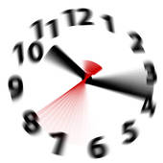
And…we’re done!
At 9:00 A.M. Johnston and the four Indians appeared before Jones, General Clayton B. Vogel, and others to conduct their demonstration.
Within seconds, the six messages were transmitted in Navajo, received, decoded, and correctly relayed to Major Jones.
"It goes in, in Navajo? And it comes out in English?" questioned one rather surprised officer. In later tests, three code experts from the United States Navy failed to decipher "intercepted" transmissions; the system "seemed foolproof." Both Jones and Vogel were immensely impressed.

Slide 15
A Successful Demonstration = Pilot Program
Major General Vogel sent a letter to the Commandant of the United States Marine Corps recommending that they enlist 200 Navajos for this assignment.
In response to the request, they were only given permission to begin a "pilot project" by recruiting 30 Navajos and forming the 382nd Platoon for the Indian specialists.
Their elite unit formed in early 1942 when the first 29 Navajo Code Talkers were recruited by Johnston. Although the code was modified and expanded throughout the war, this first group was the one to conceive it.
Even though it was Johnston’s idea, as a civilian, he wasn’t allowed to help create the code.

Slide 16
Going to War
The Indian recruits received basic training and advanced infantry training in San Diego before they were informed of their particular task.
Many of these young Navajos had never been off the reservation, making their transition to military life even more difficult. Yet they persevered.

Slide 17
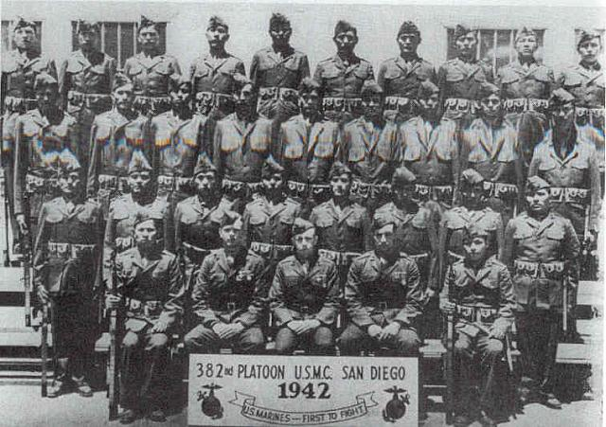

Slide 18
Challenging Task
To a man, the Indians responded enthusiastically and began the construction of a code. They worked night and day helping to create the code and to learn it. The initial problem centered on the transfer of military terms and phrases to the Navajo language.
This proved especially difficult since most of the terms to be encoded had no counterpart among Indians.

Slide 19
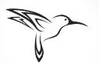
Keep It Simple
It was recognized that coded expressions demanded simplicity.
Under combat conditions, rapid transmission and translation was critical.
Instead of adding the direct term "machine gun" to the Navajo language, they would designate a word or two already in the Navajo language for the military term.
Lengthy phrases, or those difficult to remember, might prove too time consuming.
To avoid confusion, the Navajos selected words that held direct association with nature or with their common reservation life. For example, the term for "machine gun" became "rapid-fire gun," the term for "battleship" became "whale," and the term for "fighter plane" became "hummingbird."

Slide 20
Word Perfect, Every Time
Once the code was created, the Navajo recruits were tested and re-tested.
There could be no mistakes in any of the translations and in the field they would not be allowed to write any part of the code down as a reference.
They had to become living codes, and even under stressful battle conditions, had to be able to rapidly recall every word with utmost precision since one mistranslated word could lead to the death of hundreds, or even thousands.

Slide 21
A Good Start
The initial code consisted of translations for 211 English words most frequently used in military conversations. Included in the list were terms for officers, terms for airplanes, terms for months, and an extensive general vocabulary.
Also included were Navajo equivalents for the English alphabet so that the code talkers could spell out names or specific places.

Slide 22
Spell it Out!
Two methods of communication emerged. The first rested squarely on a "words for alphabet" system. Certain terms, particularly names, could not easily be given a specific code word. Simply trying to affix an Indian word to each of the Pacific islands on which Marines would land proved futile.
Under the alphabet method, each of the twenty-six letters of the English alphabet would be represented by an Indian term. For example, the island Tarawa would be transmitted as "turkey-ant-rabbit-ant-weasel-ant." In Navajo, the words would be pronounced "Than-zie, wol-la-chee, gah, wol-lo-chee, gloe-ih, wol-la-chee." To avoid repetition, which would make the code penetrable, letters carried multiple terms.
The letter "a" also stood for apple (be-la-sana) and axe (tse-nihl). A "t" was represented by tea (dah) and tooth (awoh). In this fashion, the code talkers created forty-four words for letters in the alphabet, the most numerous variations given to those vowels and consonants most frequently repeated. Tarawa, then, might be coded as "dah, be-la-sana, dah-nas-tsa, tse-nihl, glowih, wol-la-chee."

Slide 23
Adding Variety
Due to concerns about repetition leading to code breaking, an additional 200 words and additional Navajo equivalents for the 12 most often used letters (A, D, E, I, H, L, N, O, R, S, T, U) were added. The code, now complete, consisted of 411 terms.
Examples:
tortoise, "chay-da-gahi," meant tank
"besh-lo" (iron fish) meant submarine
"ne-he-mah" (our mother) meant America.

Slide 24
Code Talkers
The name code talkers is strongly associated with Navajo speakers.
Code talking, however, was pioneered by Choctaw Indians serving in the U.S. Army during World War I. Other Native American code talkers were deployed by the United States Army during World War II, including Cherokee, Choctaw, Lakota, Meskwaki, and Comanche soldiers.
Additionally, soldiers of Basque ancestry were used for code talking by the U.S. Marines during World War II in areas where other Basque speakers were not expected to be operating.

Slide 25
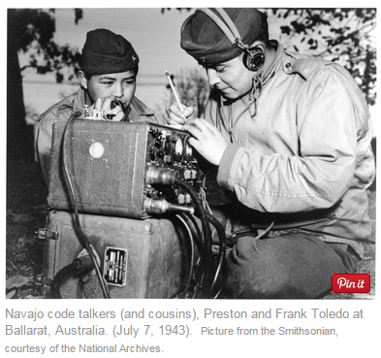
Talk Fast!
On the battlefield, the code was never written down, it was always spoken. In training, they had been repeatedly drilled with all 411 terms. The Navajo code talkers had to be able to send and receive the code as fast as possible. There was no time for hesitation. Trained and now fluent in the code, the Navajo code talkers were ready for battle.

Slide 26
Ready for Combat & Training
Once the first 29 were trained, two remained behind to become instructors for future Navajo code talkers and the other 27 were sent to Guadalcanal to be the first to use the new code in combat.
In addition, Philip Johnston, though already in his forties, petitioned the Marine Corps for his own enlistment as training specialist.
Having not gotten to participate in the creation of the code because he was a civilian, Johnston volunteered to enlist if he could participate in the program. His offer was accepted and Johnston took over the training aspect of the program.

Slide 27
Success!
The program proved successful and soon the U.S. Marine Corps authorized unlimited recruiting for the Navajo code talkers program.
The entire Navajo nation consisted of only 50,000 people, over 3,600 Navajos served in WWII, and by the end of the war 420 Navajo men worked as code talkers

Slide 28
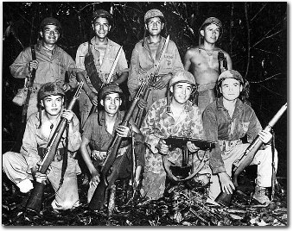
On the Battlefield
From 1942 until 1945, Navajo code talkers participated in numerous battles in the Pacific, including Guadalcanal, Iwo Jima, Peleliu, and Tarawa. They not only worked in communications but also as regular soldiers, facing the same horrors of war as other soldiers.

Slide 29
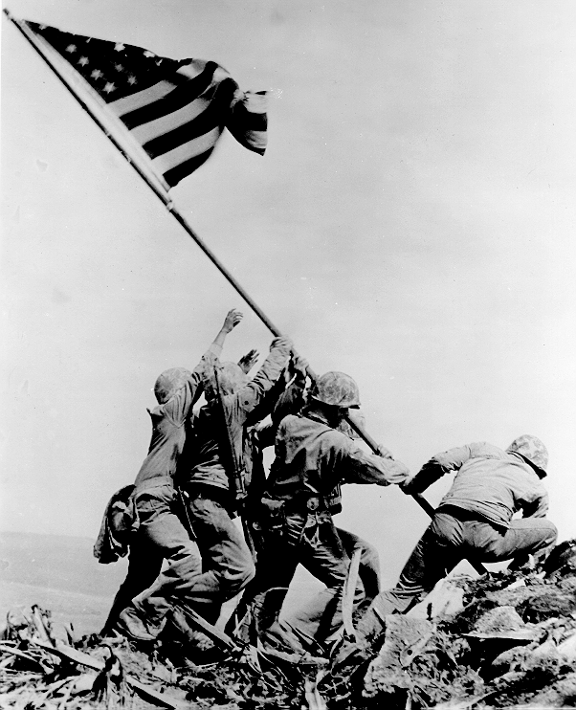
Iwo Jima
The invasion of Iwo Jima began on February 19, 1945, and continued to March 26, 1945.
The battle was marked by some of the fiercest fighting of the War.
Of the 21,000 Japanese soldiers present at the beginning of the battle, over 19,000 were killed and only 1,083 taken prisoner.
The taking of Mount Suribachi was communicated by Navajo.
The bombing of Hiroshima was also communicated by Navajo.
Notes:
SURIBACHI - "sheep-uncle-ram-ice-bear-ant-cat-horse-itch.”
Dibe, Jzhee Yazz, …, tsiin, shush, wolachee, massii, tliiih, …

Slide 30
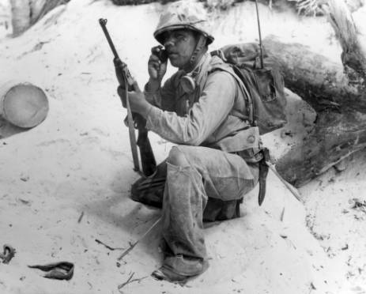
A Different Set of Problems
Beyond what all soldiers faced, Navajo code talkers met additional problems in the field.
Too often, their own soldiers mistook them for Japanese soldiers. Many were nearly shot because of this. The danger and frequency of misidentification caused some commanders to order a bodyguard for each Navajo code talker.

Slide 31
Unable to Understand
“For three years, wherever the Marines landed, the Japanese got an earful of strange gurgling noises interspersed with other sounds resembling the call of a Tibetan monk and the sound of a hot water bottle being emptied. Huddled over their radio sets in bobbing assault barges, in foxholes on the beach, in slit trenches, deep in the jungle, the Navajo Marines transmitted and received messages, orders, vital information. The Japanese ground their teeth and committed hari-kari.*”
* Excerpt from the September 18, 1945 issues of the San Diego Union as quoted in Doris A. Paul, The Navajo Code Talkers (Pittsburgh: Dorrance Publishing Co., 1973) 99.

Slide 32
Recap: The Code
It was effective because it was unwritten, not spoken by outsiders, & very difficult to learn.
The code they created at Camp Pendleton originated as approximately 200 terms—growing to over 600 by war's end—and could communicate in 20 seconds what took coding machines of the time 30 minutes to do.
It was a code within a code meaning that even Navajo speakers unfamiliar with the code would not be able to decipher
In the battle for Iwo Jima, in the first 48 hours alone, they coded over 800 transmissions with perfect accuracy.

Slide 33
Coming Home
After the war, the Navajo Code Talkers returned home as heroes without a heroes' welcome.
Their code had been so successful, it was considered a military secret too important to divulge. (It was never broken.) They remained silent heroes until more than two decades later.
Even after declassification of the code in 1968, it took many years before any official recognition was given.
In 2001, nearly 60 years after they created their legendary code, the Navajo Code Talkers finally receive well-deserved Congressional Medals of Honor. The medals were presented by then-Pres. George W. Bush who praised the Code Talkers as men “who, in a desperate hour, gave their country a service only they could give.”
Now, in their 80's and 90's, only a few remain.

Slide 34
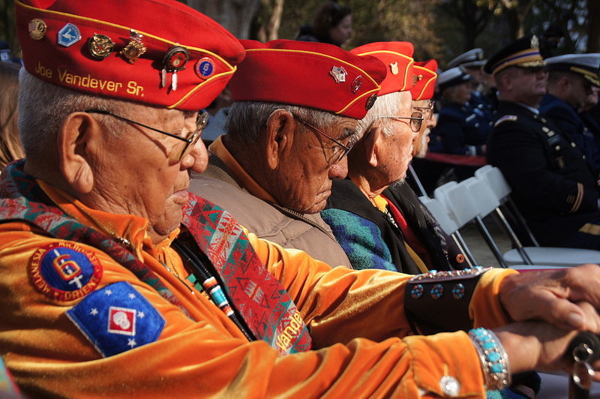

Slide 35
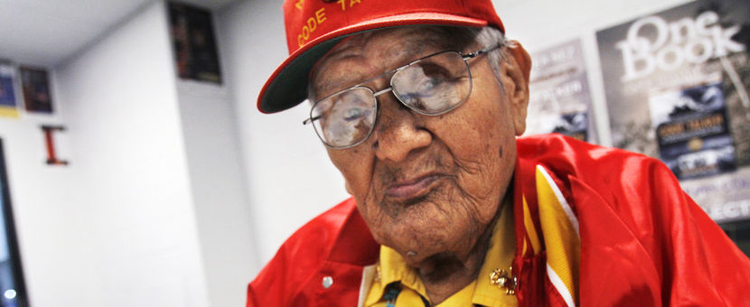
In June of 2014, Chester Nez, the last surviving original Navajo Code Talker passed away. Nez was 93.
Notes:
Navajo Code Talker Chester Nez waits backstage for a speaking engagement at the Henderson Fine Arts Center at San Juan College in Farmington, N.M., Nov. 1, 2012.
Photo by Jon Austria/AP http://www.msnbc.com/the-last-word/last-wwii-navajo-code-talkers-dies

Slide 36
Code Talker Legacy
Their heroism is widely acknowledged as the lynchpin of victory in the pivotal conflict.
Many of their stories have yet to be documented for posterity.
The Navajo Code Talker Association created in the 2009 is working to create a lasting Navajo Code Talker legacy.
Explore the greatest stories never told and watch interviews with real life code talkers visit: www.navajocodetalkers.org
Watch the 9 minute film Saved By Our Language: The Story of the Navajo Code Talkers of WWII at http://navajocodetalkers.org/story-of-the-navajo-code-talkers/

